Slide 1
Impact of School Resources and Demographics on District Test Score Performance
https://www.canva.com/design/DAGkoh9OX-k/FIDZEnbZDIsd6s-4sqY_NA/edit?utm_content=DAGkoh9OX-k&utm_campaign=designshare&utm_medium=link2&utm_source=sharebutton

Slide 2
Introduction
How do variations in school resources and district-level demographics affect a school district’s likelihood of performing above the national average in standardized test scores?
Motivation:
National debates on funding equity.
Policy implications for resource allocation and achievement gaps.

Slide 3
Methodology
Binary Classification: class_outcome based on performance vs. national average.
Models Used:
Logistic Regression (with stepwise selection)
Random Forest, SVM, LDA, QDA, kNN, GBM
Validation:
10-fold cross-validation to optimize probability threshold.
Model comparison on accuracy, AUC, sensitivity, and specificity.

Slide 4
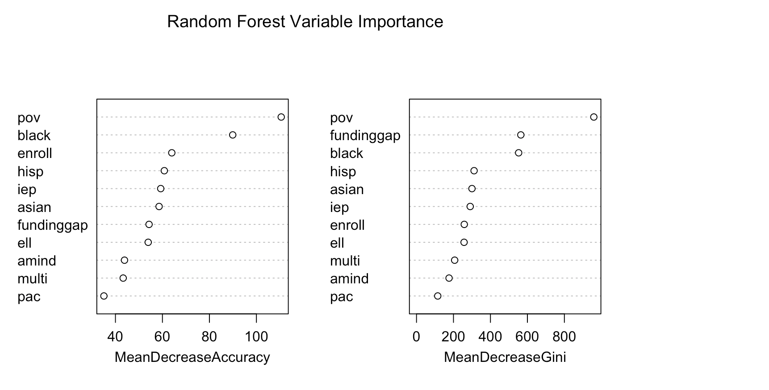
Northeast
Best Model: Random Forest (90.8% accuracy).
Top Predictors:
Poverty Rate, Racial/Ethnic Composition,
Funding Gap
Key Takeaway:
Demographics more predictive than funding adequacy.
Variables that perform well on both MDA and MDG = most critical for policy.

Slide 5
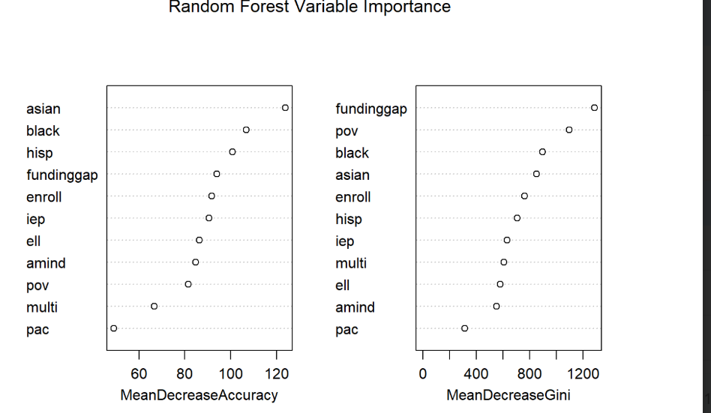
South
Best Model: Random Forest (85% accuracy).
Top Predictors:
Funding Gap, Black and Asian racial composition, Poverty Rate.
Insights:
High influence of race and poverty.
Logistic regression confirms strong negative impact of poverty and Black/Special Ed indicators.
Possible regional inequities in funding distribution.

Slide 6
Midwest
Best Model: Random Forest (80.7% accuracy, AUC = 0.886).
Top Predictors:
Funding Gap, Poverty Rate
Notes:
Model better at predicting underperformance (specificity = 85.5%).
Lower predictive power possibly due to intra-regional heterogeneity.
GLM results reinforce significance of funding and poverty.

Slide 7
West
Best Model: Random Forest (87.8% accuracy, AUC = 0.9431).
Top Predictors:
Enrollment Size, Native American %, Poverty Rate.
Model Insights:
Optimized threshold (0.45) improves classification metrics.
Strong performance of ensemble models vs. linear ones.
Socioeconomic status and resource gaps remain dominant predictors.

Slide 8
Regional Synthesis
Common Patterns:
Poverty and Funding Gap consistently predict outcomes.
Random Forest outperforms other models in all regions.
Differences:
Demographic weight varies by region (e.g., race in South/Northeast)
Model sensitivity differs — Midwest strongest at identifying underperformance.

Slide 9
***POTENTIAL GRAPH*** (Rene)
Boxplot maybe with schools that are majority? Showing the funding gaps amongst different racial groups
Perhaps this is a is a consequence of systemic racism via poverty,

Slide 10
Policy and Economic Implications
Policy Relevance:
Targeted interventions in high-poverty districts.
Re-evaluating funding formulas to ensure adequacy.
Economic Insight:
Diminishing returns to spending — smart allocation > blanket increases.
Regional differences imply state-specific strategies needed.

Slide 11
Conclusion
Main Findings:
Demographics and funding adequacy jointly shape district outcomes.
Binary classification adds clarity for policy decisions.
Model Takeaway:
Ensemble methods (e.g., Random Forest) yield strongest predictive performance.
Future Work:
Extend to panel analysis for causal inference.
Include instructional practice and teacher quality data

